Slide 1
The Value ProLiant Gen8 Delivers to the Channel
Juan Carlos Perez
Worldwide Director, Field Enablement and SMB Business Development
Industry Standard Servers and Software
June 5, 2012

Slide 2
Agenda
Transforming the x86 Server Market (JC Perez)
Blades & Cloud (Vance Baran)
e-Series and the SMB (Patricia Arboleda)
HP iQuote (Patricia Arboleda)
Resources and Programs to Boost Sales

Slide 3
Transforming the x86 Server Market Juan Carlos Perez

Slide 4


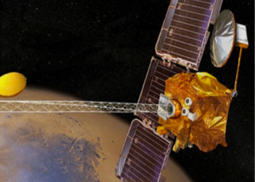

Transforming the Server Industry in 100 Days
Project Moonshot Delivering the future of extreme low-energy computing
Project Odyssey Redefining the future of mission-critical systems
Project Voyager Redefining the expectations and economics of data centers
Announced Nov. 1, 2011
Announced Nov. 22, 2011
Feb. 13, 2012
4
Notes:
We’ve announced Project Moonshot targeting low-energy computing, Project Odyssey focused on mission-critical.
Announcing Project Voyager February 13: A multi year, multi generational effort to redefine the expectations and economics of data centers.

Slide 5
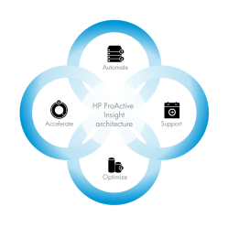
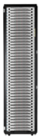
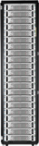
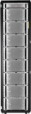
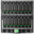
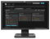

Introducing HP Project Voyager
A multi-year, multi-generational journey
ProLiant Gen8 Portfolio
Architecture
Ecosystem
Supply chain
IHV/ISV
ServiceONE
OEM
Notes:
HP believes that a key to help IT respond to the cloud era, is to make systems infinitely smarter – enabling them to learn, connect and adapt.
After two years of research and over 200 million in R&D investment, HP is poised to reveal our next initiative, Project Voyager, which aims to redefine the expectations of IT infrastructure.
Project Voyager is a multi year, multi generational journey to redefine the economics and expectations of data centers. We are announcing a new architecture, called ProActive Insight architecture, an expanded ecosystem that will include new programs and partners, and our new HP ProLiant Gen8 with ProActive Insight architecture built in.

Slide 6
Competition playing catch-up to ProLiant Gen8
HP is transforming the economics and expectations of an industry
ProLiant Gen8 raises the bar…
…and others copy and imitate
Intelligence and automation benefits across the lifecycle and data center
Integrated Lifecycle Automation | Dynamic Workload Acceleration | Automated Energy Optimization | Proactive Service & Support
3x Admin productivity improvement | 6x Performance increase for the most demanding workloads | 70% More compute per watt | 66% Faster time to problem resolution
IBM
“New family of expert integrated computing systems designed to radically simplify enterprise computing by making it easier, more secure and less expensive to own and maintain”
“Change Your Data Center Economics Cisco UCS solves real-world challenges for customers and delivers results”
“With this new server series, customers can help maximize efficiency by streamlining and automating operations, help achieve better business application performance and business continuity”
CISCO
DELL
And beyond servers, to storage and networking…and the Converged Cloud
Notes:
But while competitors are playing catch-up, we’re full after-burner!
Across the industry and customers, we’re seeing unprecedented response, that Gen8 is the game-changing foundation they want to invest in, and build upon for their future.
Customer: already with thousands and thousands of customers transitioned to buying Gen8 servers
Channel: already 4,500 channel partners through training, with 2X more expected in next few months
ProActive Insight Architecture Alliance: An industry-first and only coalition 19 of top technology providers allied with HP to transform the datacenter
Software industry leaders, including Microsoft, Red Hat, SAP and VMware innovating solutions on Gen8
OEM: Gen8 rapidly becoming the platform of choice for OEM solution across the spectrum of industry verticals including telecommunications, medical, transportation, aerospace, defense and industrial automation.

Slide 7





Customers and partners agree …
“… HP proves once more that they are the technological leaders and this is what we need in our very demanding environment.”
“… Gen8 was designed with Partner innovation in mind”
“Citigroup is modernizing its datacenters … and saw strong test results related to platform consolidation and performance.“
“… cuts my hardware investments in half”
“… we saw a doubling of performance versus our existing solution at a similar price point. ”
“.. we’ve seen a significant leap in the performance of our critical applications”
Notes:
7

Slide 8





Unprecedented press and analyst coverage
“HP has hit the nail on the head with its new features”
“Great focus on measurable benefits and HP differentiation
…amazed by your focus on benefits, and innovation …some really neat things for channel partners to build services around…”
- Mark Fabbi
HP Watcher
-Tarun Bhasin
“… an impressive suite of offerings … one of the most impressive announcements from any vendor...”
“… over 160 different upgrades and new features .. Including automatic updating of security patches that can cut server provisioning time to 10 minutes …”
-Rob Enderle, president
and principal The Enderle
Group
-Quentin Hardy
“.. incrementally more positive on HP's ability to regain share in the x86 server market…”
“…really impressed with HP Server vision...”
- John Furrier @Furrier
SiliconAngle
-Aaron Rakers
Stifel Nicolaus
Notes:
8

Slide 9



ProLiant Gen8 Advantages for HP Partners
Technology innovations that drive business results
Reach More
Customers
Sell Higher Value
w/o Incremental Resources
Increase Customer Loyalty
Increase Revenue
Increase Margin
Secure Revenue Streams
Notes:
HP ProLiant Gen8 has been redesign from the floor up to create unprecedented customer and channel partner innovation. In this document (slides) we will concentrate on how HP ProLiant Gen8 makes business sense for our channel partners.
Gen 8 introduces Partner Innovation in 3 ways:
First, HP ProLiant Gen8 severs are so intelligent they help you reach more customers and maximize every sales opportunity with your customer installed base; in a nut shell, Gen8 is designed to help you increase revenue streams
Second, HP ProLiant Gen8 severs are so intelligent they help you sell higher value services and solutions without increasing your resources; this means increased margins
And third, HP ProLiant Gen8 severs are so intelligent they help you increase customer loyalty, which means securing revenue streams
Let’s take a quick view on how Gen8 delivers on these three promises to you, our channel partners...

Slide 10
Integrated Lifecycle Automation

Slide 11
Integrated Lifecycle Automation
Servers so intelligent they eliminate tedious, time-consuming tasks
Built-in intelligence for simplified setup and maintenance
Consistent management and updates across the server lifecycle
Automated monitoring and self-diagnosis
Active Health
5x
Faster to problem analysis
Smart Update
69%
Less operator time for updates
Intelligent Provisioning
3x
Faster system deployment
Notes:
In today’s data centers, life is harder than it should be. In too many cases, server management tasks keep administrators running from problem to problem. The workday is a stream of error alerts, system events, installation and update tasks, and calls to support desks. In the cloud era, these demands are only multiplied.
HP ProLiant Gen8 is the result of a comprehensive HP effort to take the IT administration experience to an all-new, simplified level. To achieve that, the goal from the outset was to make servers that are so smart, they virtually manage themselves. With its HP ProActive Insight architecture embedded inside each ProLiant server, clients gain insight and a rich set of capabilities that automate and simplify system provisioning, troubleshooting and firmware and software updates.
Taking advantage of an industry-first Active Health system, embedded tools, simplified firmware and software maintenance process, and agentless management, HP ProLiant servers use intelligence to automate your most common tasks during each step of the IT lifecycle. Active Health system also continuously monitors and securely logs over 1600 system parameters and 100% of all configuration changes, empowering you with the insight to keep your systems running at peak performance with minimal downtime and effort. With smarter servers behind you and your business, you can get systems online 3x faster, start troubleshooting 5x faster with more context and accuracy, and deploy updates 3x faster with 93% less downtime during online updates. Less interaction required during the update process reduces operator time by 69%

Slide 12
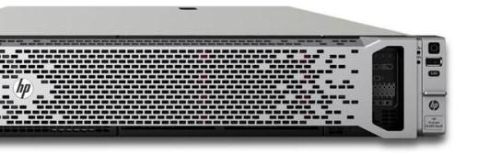
Innovations in Integrated Lifecycle Automation
64 embedded intelligent temp. sensors
Built-in analytics & smart algorithms
+1600 data points continuously analyzed
100% agentless management software
Next generation iLO and Smart Array
Triple administrator productivity*
*With Smart Update

Slide 13



Benefits for partners
Sell more, reduce cost of delivery and open new revenue opportunities
Intelligent Provisioning | Active Health | Smart Update
Reduce time and complexity of deployment services making consultants more productive | Automatically monitors health and configuration with easy set up to feed Insight Online for detailed views of what’s going on in your customer’s environment | Enables practical maintenance with little downtime, perfect for new chargeable compliance services for customers

Slide 14
Dynamic Workload Acceleration

Slide 15
Dynamic Workload Acceleration
Servers so intelligent they turbo-charge application performance
Unified compute, storage and I/O
Engineered for solid state performance
Intelligent analytics to manage performance, capacity and resiliency in real-time
Solid State Optimized
6x
Storage performance improvement
Smart Data Protection
1000x
Resilience for critical data
Smart Data Services
50%
Increase in transactional workload

Slide 16
The Ripple Effect of Data Growth on Servers
For every $1 spent on storage…
45% annual storage growth
The untold story: $8.7M storage growth requires incremental $60M of data center expense
28.2 PB
90¢
$2.70
$3.30
6.5 PB
Servers
Server Admin/Operations
Facilities
Typical 10K square foot datacenter
Notes:
Society’s insatiable demand for all things digital is creating a well-documented increase in storage. In a typical data center, this means that 9.4 petabytes of stored data today will grow to 28.2 petabytes.
The untold story is the ripple effect this creates. For each dollar spent on storage, nearly $7 will be spent on associate servers, admins and facilities. This equates to a $60M incremental annual cost to already-strained data centers.
This why we created Project Voyager.
----------------------------
The Math:
For every $1 spent on Storage growth in today’s large enterprise data center (10k ft²) $6.9 is spent on Servers, Power/Cooling and Administration/Maintenance of that server. (Gartner, Data Center Demographics and Sizing, 2010)
Storage capacity is going up 45% annually (IDC Q3 DSS Storage Market Forecast, 2011)
A typical 10000 sq ft large data center
1:6 ratio (storage:servers)
27 Storage Racks : 144 Server Racks
$49,010/Array $3,953/Server
8 Arrays/Rack 12 Servers/Rack
Avg disk capacity=1.7TB; Total capacity per array (12 disks) = 20.4TB; Avg storage per rack = 163TB; 10.1 PB per data center
7.68 Kw each rack 6.0 Kw each rack
1 Rack = 12 ft² floor space
41.4% capacity growth YoY (mix between structured and unstructured data growth)
New storage purchased in year 2 = 14PB
Avg disk capacity=2.9TB = 2,148 Disks
23 Storage Racks : 161 Server Racks
$49,010/Array $3,953/Server
8 Arrays/Rack 12 Servers/Rack
7.68 Kw each rack 6.0 Kw each rack
1 Rack = 12 ft² floor space
2584 Kw added with new hardware (assuming redundant Power supplies)
$8.7M Storage in Year 2
$7.6M Servers
$29M Power/Cooling/Facilities
$17.4.M Admin/Maintenance and Management

Slide 17
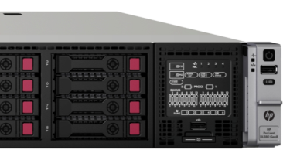
Innovations in Dynamic Workload Acceleration
2x more storage per server
Real-time workload tuning
Smart Analytics and new algorithms
Solid State Optimized
Foundation for Smart Caching
95%
faster RAID Setup
Notes:
Placeholder: 500k IOPs per DL380 server
10 million IOPs per rack

Slide 18
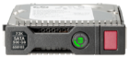

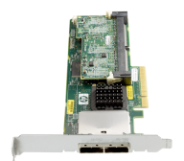
Benefits for partners
Sell more, reduce cost of delivery and open new revenue opportunities
Solid State Optimized | Smart Data Protection | Smart Data Services
Upsell customers to SSD storage cost-effectively using Smart Array technology | 3-drive mirroring secures data 1000x more by simply selling 50% more drive capacity than traditional mirroring | Performance opens new RISC- or mainframe-alternative transition programs using familiar ProLiant technology

Slide 19
Automated Energy Optimization

Slide 20
Automated Energy Optimization
Servers so intelligent they maximize use of space, power and cooling
Self-identification and location
Efficient power supplies, system memory and onboard sensors
Automatic power configuration
Reduce Power
10%
Less energy consumed
Reclaim Resources
10%
More usable power per circuit
Eliminate Errors
100%
Manual, error prone inventory tracking eliminated

Slide 21
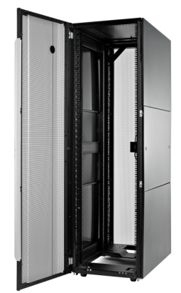
Innovations in Automated Energy Optimization
Data Center Discovery technologies enabled by:
New intelligent racks, PDUs and power supplies
Built-in location sensors automate asset tracking
Automated power configuration setup
Rack-level power capping
70% more compute per watt

Slide 22
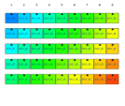
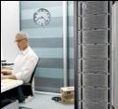

Benefits for partners
Sell more, reduce cost of delivery and open new revenue opportunities
Reduce Power | Reclaim Resources | Eliminate Errors
Opens consulting and services opportunities tied to top priorities for all CIOs Expands your influence within the data center, extending into facilities organizations and departments Tightly-coupled infrastructure ecosystem enables more add-on sales |  | More efficient tracking to capture contract renewals and to help customers retire depreciated equipment enabling new sales

Slide 23
Proactive Service and Support

Slide 24
Proactive Service and Support
Servers so intelligent they redefine the service experience
Industry’s first comprehensive cloud-based, IT management and support portal
Innovative services based on HP ProActive Insight architecture
Local expertise backed by HP’s global resources
Insight Online
66%
Faster time to problem resolution
Proactive Support Services
95%
First time fix rate*
ServiceONE Advantage
2,000
Certified partners worldwide
*TSIA study
Notes:
By putting more intelligence at the intersection of technology and people, HP is redefining the expectations and economics of the IT support and service experience. Taking advantage of the rich data collected by the ProActive Insight Architecture, HP created Insight Online, the industry’s first comprehensive cloud-based IT management and support portal with a personalized dashboard for your HP environment.
Proactive Support Services - HP is able to achieve an industry-leading first time fix rate of 95%, a full 10% above the industry average of 85% (according to data in a study done by the Technology Services Industry Association)
[With over 8,000 HP Gen8 experts and] 2,000 ServiceONE certified partners, HP is able to deliver unique support and services that are intuitive, dynamic, and automated. Taking advantage of the intelligence of Insight Online, HP experts can now help clients proactively resolve issues, deliver real-time insight and continuously improve data center performance and results. This results in 66% faster time to problem resolution*.
*66% Faster time to problem resolution - HP Insight Remote Support-initiated cases (HW) vs. traditional phone support. Source: HP internal call center data, Q4’11 Calculation based on average of 7.1 hours for an Insight Remote Support initiated cases vs 11.8 hours for phone-initiated cases

Slide 25
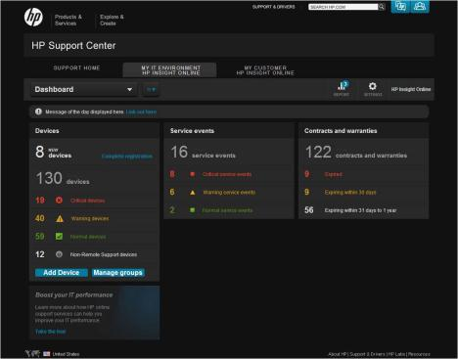
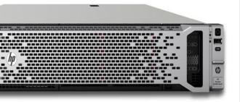
HP Insight Online
Monitor IT environment, support, contract and warranty information
First comprehensive cloud-based
support portal
Anywhere, anytime, any device access
Notes:
Industry’s first comprehensive cloud-based, management and support portal with a personalized dashboard for monitoring device and support status.
HP Insight online transforms the typical support experience by automatically collecting a comprehensive view of your assets so you spend less time searching for information, less time on the phone and more time up and running.
Insight Online aggregates all system health, asset and warranty information from the HP ProActive Insight architecture (& Insight Remote Support) and secures it in one place, accessible anywhere, anytime and from any device.
The unique interface cleanly organizes your IT and service data and adds rich context to help you collect and understand key information that will save you time during your support experience.
For example, as much as 90% time saved in tracking status of contracts and warranties and up to an 85% time savings tracking asset configurations. When you enable the Insight Remote Support feature, it connects that rich data directly to your HP Certified Service Professional to accelerate time to problem resolution by 66%

Slide 26



Benefits for partners
Sell more, reduce cost of delivery and open new revenue opportunities
Insight Online | Proactive Support Services | ServiceONE Advantage
Complete insight into customer fleet and health without having to build your own infrastructure | Problem resolution times reduced and first-time fix ratios improved meaning you minimize costly redos and free up time for more productive and revenue-generating tasks | Designation endorsing you as an authorized services and consulting delivery organization, boosting your credibility and close ratio
Notes:
Establish, enable, or expand your services capabilities in an affordable way.

Slide 27
And More..

Slide 28
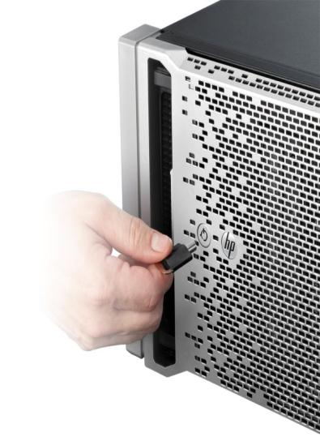
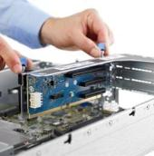
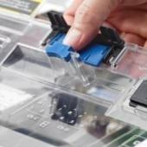
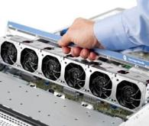
Over 150 Design Innovations
Customer-inspired engineering
Intelligent components built in
Intuitive consistent design philosophy
Hassle-free serviceability
Notes:
Client inspired, intuitive, and precise: From the moment you see your first ProLiant Gen8 server emerge from the box to the first time you touch the precise design; you will feel and see the quality built in. Guided by the ‘Client-2-Innovation’ design philosophy, HP engineers and developers created over 150 innovations that help get tasks done simply, reliably and with confidence. Clients who have trusted ProLiant for years will be instantly familiar with the consistent experience and yet appreciate the attention to detail of the new features and design. The result means more productivity for you and your team and more of your servers and applications are up and running faster for the business.
Design and feature changes documented by HP ProLiant mechanical design teams
With over 20 year of leadership in the industry standard server market, HP has learned many design principles that are resulting in better quality, reliability and serviceability. Today, with the HP ProActive Insight architecture, our engineers will gain even more useful insight into methods to further improve your experience and how your IT can operate more efficiently. The next generation of ProLiant is setting the new bar for smart infrastructure. With this wealth of client inspired knowledge, Only HP will be able to quickly identify key product and process opportunities to increase quality and deliver both increased uptime and improved business results.
Designed-in quality: Intelligent system components help administrators virtually eliminate common problems that cause failures, downtime and data loss
Intuitive simplicity: Simple and consistent design philosophy and user interface delivers an intuitive, efficient experience
Hassle-free serviceability: Over 150 design innovations to increase your productivity and confidence during setup, upgrade and repair

Slide 29
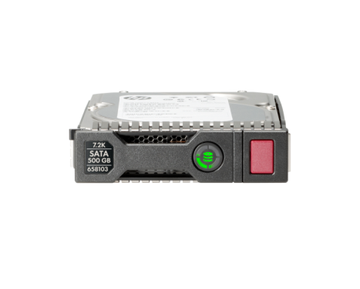
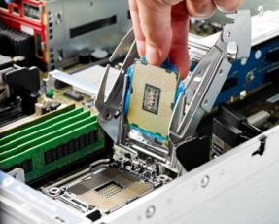
Better Design Reduces Unplanned Downtime
Examples of customer-driven innovations in ProLiant Gen8 servers
HP Smart Socket
Addresses the leading cause of motherboard failures
HP Smart Drive
Do-not remove LED addresses the leading cause of data loss due to human error
Notes:
Focusing on two key innovations that target reducing unplanned downtime.
First is Smart Socket, which addresses the leading cause of motherboard failures by providing an accurate guide for installation of the microprocessor to avoid bending of pins.
Second is HP Smart Drive, which has a clear LED on the front indicating whether that disc is involved in application activity. Red if active and green if ok to remove, this simple light helps eliminate the leading cause of data loss due to human error.

Slide 30

Deliver Better Customer Experience
Focus on business discussions and not administrative tasks
Simplified provisioning, troubleshooting, and software updates
Intuitive & configurable management system eliminates tedious, time-consuming tasks
45%
Less startup steps eliminated
5x
Faster problem analysis
93%
Less downtime during online updates
One-click systematically updates servers and blade infrastructures at the scale of your data center
Notes:
HP ProLiant Gen8 clearly delivers a significant better customer experience. This experience means that:
One, your existing customers will be even more satisfied with your service and support
And two, allow you to spend less time differentiating our servers from our competitors, therefore spending more time developing and selling more profitable value add services
For example:
Innovations like Integrated Lifecycle Automation allow HP to get a server up and running in aprox. 4 minutes where it takes the average competitive server 28 minutes. And while the 7 times faster server deployment time is quite impressive, a faster set up is just the beginning. It is HP ProLiant Gen8 servers’ intelligence that enables our servers to identify any part in the server that might be malfunctioning at the time of deployment, and with Insight Remote Support and Insight Online, notify you anywhere anytime.
This capability, for example, not only saves you and your customer deployment time, but can translate into something as simple but as significant as you showing up and replacing a NIC, as opposed to having to return a server to the Dell, CISCO, or IBM customer center for a server replacement.
Innovations like Active Health System, which is a diagnostics system for your server that is always running, captures and journal over 1600 hundred attributes including hardware changes, configuration changes, as well as temperature and voltage variations. Key elements of this intelligence are then sent up to the Insight Online portal for you and your customers. So if a server fails, HP support engineers are able to identify the most elusive issue in the minimum amount of time.
These are just two of the many unique differentiators in HP ProLiant Gen8 that are designed to help you change your customers’ experience. These service centric examples, paired with technical advantages like:
the built in intelligence that enables IT staff to run 30% more Virtual Machines per sever while seeing a reduction of 40% in energy per Virtual Machine,
or the ability to update servers online with 93% less downtime, to name two
are at the heart of delivering a better customer experience.

Slide 31
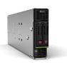
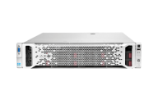
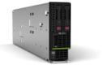
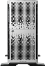
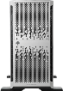
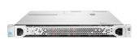
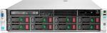
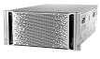
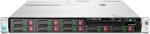
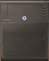
HP ProLiant Gen8 Server Portfolio
Ready to help your business grow…and grow easily with your business
HP ProLiant Blades 400
Ideal balance of performance, density, and efficiency for enterprise applications
HP ProLiant p-Series
High-performance servers ideal for more demanding applications
HP ProLiant e-Series
Essential servers ideal for everyday business needs
HP ProLiant MicroServer
Affordable server within reach of every small business
ML350 Family
DL360 Family
Essential performance with versatility and room to grow
Optimized for size and storage.
Best-in-class compute and storage in 1U
DL380 Family
Industry leading serviceability, expandability and flexibility in 2U
Notes:
And that is exactly what we did with the Gen8 Server Portfolio. A simple set of choices designed to meet the needs of the growing business.
If you look across the portfolio we have the platforms to address the datacenter, branch office or other remote or small locations. The ProLiant portfolio goes from the MicroServer, all the way to Blades. And we have expanded our 300 series products to the ‘p’ series and ‘e’ series lines. For the majority of our customers the p-series product line delivers the best overall TCO and performance. The e-Series is a result of our focus on the growing business. The e-Series is a continuation of our 100 series portfolio, but now delivers the full ProLiant experience. For growing businesses, the e-Series offers ProLiant Manageability, the right mix of capabilities for the typical growing business at the best overall acquisition price.

Slide 32
Blades and Cloud Vance Baran Manager, WW Enterprise Field Enablement Industry Standard Servers and Software

Slide 33
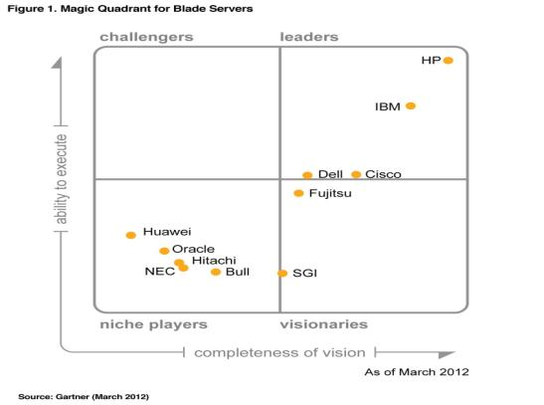
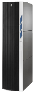
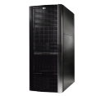

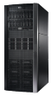
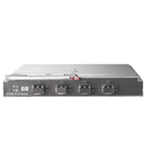
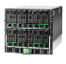
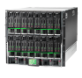
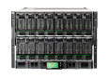
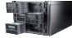

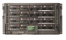
One Converged Infrastructure from Client to Cloud
Most complete, open, integrated system for Cloud
1st Mission Critical Converged Infrastructure
#1 platform on Top 500 list for HPC
#1 Blade for Enterprise Data Centers
#1 SMB blade, Optimized for the “undatacenter”
1st highly optimized solution for Client Virtualization
#1 in Blades
In market share
and revenue
2.7 million
Blades shipped - more than Dell, IBM, and Cisco combined!
5 million
Virtual Connect ports delivered
6 million
Insight Management licenses
This Magic Quadrant graphic was published by Gartner Inc. as part of a larger research note and should be evaluated in the context of the entire report. The Gartner report is available upon request from HP. The Magic Quadrant is copyrighted 2009 by Gartner, Inc., and is reused with permission. The Magic Quadrant is a graphical representation of a marketplace at and for a specific time period. It depicts Gartner's analysis of how certain vendors measure against criteria for that marketplace, as defined by Gartner. Gartner does not endorse any vendor, product or service depicted in the Magic Quadrant, and does not advise technology users to select only those vendors placed in the "Leaders" quadrant. The Magic Quadrant is intended solely as a research tool, and is not meant to be a specific guide to action. Gartner disclaims all warranties, express or implied, with respect to this research, including any warranties of merchantability or fitness for a particular purpose.
*Based on IDC Quarterly Worldwide Server Tracker Q4 CY2011 and on internal calculations
Notes:
We talked about how the HP BladeSystem is one infrastructure that is a cloud ready architecture that can grow. Here are great examples of how we used this one infrastructure to do everything from client virtualization solutions, to simple and low-cost SMB solutions, to some of the biggest enterprise data center solutions that our out there. We are on the largest portion of the top 500 list for high-performance computing. All of these different capabilities fit within this one infrastructure that can be design to adjust with your needs over time. As an interesting note, 92% of the Global 100 are powered by BladeSystem.
The design of the HP BladeSystem has propelled us to be #1 in Blades Market share and revenue. The number of customers adopting Blades is significant with 2.4 million of blades shipped, 4.3 million of virtual connect ports shipped and over 5 million Insight Management licenses sold. In fact, HP has shipped more Blade servers than Dell, IBM and Cisco combined!
Substantiation for Quants:
“92% of the Global 100 are powered by BladeSystem” Global 100 customers from CNN list July 26th, 2010: http://money.cnn.com/magazines/fortune/global500/2010/index.html (revised yearly).
“#1 worldwide – Clear leader in blades 15 quarters in a row.” IDC Quarterly Worldwide Server Tracker Q1CY2011, preliminary data March 2011, 2002-2011 data covering HP & Compaq shipments. http://www.idctracker.com/
“2.5 Million shipped” – Shipped more than IBM, Dell and Cisco combined” HP internal analysis Q1CY2011
“4.7 Million VC ports” - VC fastest growing virtual I/O, 3x more ports than Cisco Nexus” HP internal analysis April 2011
“5 million insight licenses” HP internal analysis Q1CY2011
Sound bites:
“HP’s leadership in the datacenter has been built over decades of innovation, experience and market leadership.”
“Innovations start with the largest blade server portfolio in the industry, broadly adopted by end-users”
Notes:
HP currently has a network of more than 5,000 industry-leading vertical and infrastructure ISV partners who are an integral part of providing solutions to customers.
HP innovations continue in the areas of energy efficiency with HP Thermal Logic, and into network convergence with HP Virtual Connect Flex-10.. These are just some of the reasons that have vaulted the HP BladeSystem to the top of the blade market with more than 50% revenue and unit share.
This proven system is the foundation on which the Matrix architectural approach is built. So we know it works, and it works in real-world customer environments, not just our labs.
Additional information:
HP’s leadership in the datacenter has been built over decades of innovation, experience and market leadership.
Innovations start with the largest blade server portfolio in the industry, broadly adopted by end-users. HP has shipped over 2.4 million blade servers in the past decade.
Plus, HP currently has a network of more than 5,000 industry-leading vertical and infrastructure ISV partners who are an integral part of providing solutions to customers.
HP innovations continue in the areas of energy efficiency with HP Thermal Logic, and into network convergence with HP Virtual Connect Flex-10.. These are just some of the reasons that have vaulted the HP BladeSystem to the top of the blade market with more than 50% revenue and unit share.
This proven system is the foundation on which the Matrix architectural approach is built. So we know it works, and it works in real-world customer environments, not just our labs.
33

Slide 34

HP ProLiant Gen8 - Delivering Real Customer Value
“The Carter cluster at Purdue University, the largest campus supercomputer in the U.S., needs an IT infrastructure that can support the broad research the university supports. With HP ProLiant Gen8 servers, Carter delivers twice the performance of the school’s most recent TOP500 systems, while using half the energy of the previous systems and requires only a quarter of the datacenter space. With nearly four million hours of research computation to date, Carter is already having impact on research from cancer treatment to forecasting tornados.”
Gerry McCartney, Purdue CIO, VP for IT

Slide 35
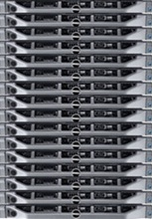
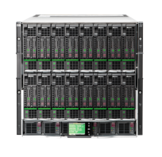

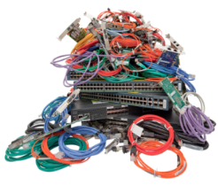
HP BladeSystem Economics
- Value For you and your customer
Traditional Infrastructure
HP BladeSystem
Differentiate & Sell More Value
Increase Deal Size and Margin
50% less hardware cost*
40% less power*
46% less set up and configuration*
Increase Customer Loyalty
Open Door For More Services
“Investment in a bladed infrastructure is paid back in just over 10 months.” –IDC*
*IDC white paper sponsored by HP, “Business Value of HP BladeSystem”, #227508 3/2011
*
Notes:
*IDC white paper sponsored by HP, “Business Value of HP BladeSystem”, #227508 3/2011
Before we jump into the technologies, let go back to the simple math, or what we like the call the “Blade-o-nomics” piece here that shows that we have significant improvements over the traditional, rack-type infrastructure. We have an example here of Dell servers and all the networking gear, cables, adapters, switches- all the infrastructure that you need for traditional infrastructure. You can take everything that you see on the left and condense it down to the HP BladeSystem as it is already designed into the infrastructure. It’s all about having less to install, less to power, and less to manage. According to a recent IDC study, IT organizations that migrated to the HP BladeSystem reduced their annual IT infrastructure cost per user by 25%. The greatest areas of savings included facilities (57%), server hardware (50%), network hardware (50%), and power and cooling (40%).
“IDC believes that the HP BladeSystem delivers improved return on infrastructure investment for customers, creating a flexible IT environment that provides for both easier IT management and easier adaptation to the changing needs of the business. IDC estimates that over a three-year period, the companies in the study saw their implementation of a bladed infrastructure deliver a return on investment (ROI) of over 251%, and cumulative savings from the implementation paid back the full investment within a period of just over 10 months.”
Substantiation for quants: Business Value of HP BladeSystem, IDC 3/2011, http://h20195.www2.hp.com/V2/GetPDF.aspx/4AA3-3868ENW.pdf
25% cost Savings: IDC whitepaper
50% savings in hardware cost: IDC whitepaper
57% savings in facility cost: IDC whitepaper
40% lower power and cooling: IDC whitepaper

Slide 36
ProLiant blade servers – Delivering Value to Partners
Close deals faster with compelling BladeSystem business value proposition
At 7 servers and above blade servers have a better TCO than rack servers, as much as a 13% improvement even in small comparisons
Every empty slot represents a future sales opportunity
Unfilled rack “U” units can be filled with any kind of equipment; a BladeSystem slot is reserved for equipment you sell
Retire quota significantly faster with ProLiant blades with higher attach and by taking out competitors’ rack servers
2x higher optioned-up AUP on blade servers
4x higher Insight Control attach
2.5x higher services attach

Slide 37
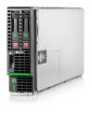
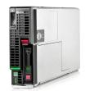

The New ProLiant BL420c and BL465c Gen8
BL420c Gen8
Breakthrough server blade economics for essential enterprise workloads
BL465c Gen8
The first server blade to deliver over 2,000 cores per rack
Entry blade with no-compromise availability
(Hot-plug drives and FBWC option)
Customize with choice of storage controller and networking
HP exclusive ProLiant Gen8 technologies (Integrated Lifecycle Automation, Smart Storage, Smart Memory)
World’s leading 2-socket AMD blade*
New Smart Array with up to 3x more HDD performance
HP exclusive ProLiant Gen8 technologies (Integrated Lifecycle Automation, Smart Storage, Smart Memory)
* Only Tier 1 AMD 2-socket blade

Slide 38
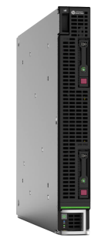
HP ProLiant BL660c Gen8 Server Series
NDA
Redefining density-optimized 4S blade technology
What’s New
4S performance and features in a single-wide, full-height form factor
Up to four cost-effective Intel® Xeon ® E5-4600 processors
32 DIMM sockets for up to 1.0TB of Gen8 HP SmartMemory
Three PCIe 3.0 expansion slots (to x16)
Gen8 FlexibleLOM solution for choice of embedded networking
Gen8 Smart Array Controller with optional 512MB FBWC
Gen8 HP iLO and cloud-enabled Insight Management
Additional Value
Ideal Environment
Virtualization/consolidation
Business processing (ERP, CRM, batch, etc)
Database
Application development
Industrial R&D
Any processor, memory, I/O bandwidth, data-intensive 4P application in general
Services

Slide 39

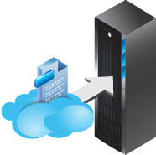
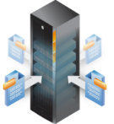


HP Provides the Best Path to the Cloud
Protection & growth for you and your customer’s investment
HP CloudSystem
Automation, orchestration, and service management
Differentiated Customer value
HP VirtualSystem
Virtual/utility storage, VMs, and
management
Partner Margin
HP BladeSystem
Industry’s leading modular architecture
and virtual connectivity

Slide 40




Enhancing HP CloudSystem
Industry’s leading cloud platform gets better
CloudSystem Design Centers
Integrate the cloud app lifecycle
Accelerate hybrid cloud adoption
Open solutions ecosystem
What’s New:
Enhanced Out-of-box bursting
On-demand storage provisioning
Extending CloudAgile
Expanding ExpertONE certification
Manage Cloud cost allocation
Cloud Maps
900+
Installs to Date
100%
100+
Cloud Centers of Excellence
1.5B
in the Pipeline
Services & Software Attach
Notes:
HP is the one vendor able—today—to deliver a comprehensive, integrated cloud solution on a single
platform, with all the attributes so prized by CIOs, service providers, and IT professionals. That solution is HP CloudSystem.
At Discover in Vienna, we will be announcing:
For Communications Service Providers creating Cloud Services, a new partnership “end to end automation of the data center infrastructure and the networking layer
new cross-EB program for service providers. HP CloudAgile program extends the reach of service providers as they work to capitalize on the cloud market place.
Delivering industry-first out-of-the-box cloud bursting which we are going to demonstrat
On-demand storage provisioning with 3PAR
And we are are extending our portfolio of technology services that help customers deploy and operationalize cloud.
2200 opportunities in the pipeline is good, but we can do better…
Transition:
Only HP can link cloud strategies for our customers with one strategy, one architecture

Slide 41
e-Series and the SMB Patricia Arboleda WW SMB Manager Industry Standard Servers and Software

Slide 42
SMB Market Overview
X86 Server SMB TAM & Market Share
X86 server WW SMB 2012 TAM is $15B with an expected CAGR of 4.1% over the next three years
X86 server WW SMB 2012 TAM represents 40% of the TOTAL TAM
WW HP x86 server all segments Market Share is 34% (2,768,189 units); WW HP x86 server SMB Market Share is 37% (1,535,233 units)
55% of HPx86 server units were sold to companies with less than a thousand employees
$6,294
$15,383
$17,159
Source: IPR/ EB Segment x Channel Model -2H11 Update- Final-Nov-21-11. EB Segment x Channel worksheet.
Units
x86 Server WW SMB Market Share
37%
4.1%
27%
CAGR 4.1%
11%
3%
2%
Source: IDC WW x86 ServerTracker_FinalHistoricalPivot_2011Q4_HP
Source: IPR/ EB Segment x Channel Model -2H11 Update- Final-Nov-21-11. EB Segment x Channel worksheet.
Notes:
The total of WW all vendors all segments x86 server units sold is 8,015,339. The SMB represents 51% with 4,105,010 units sold (according to IDC).
The total of WW all vendors SMB x86 server units sold is 4,105,010. HP represents 37% with 1,535,233 units sold (according to IDC).

Slide 43
Addressing the SMB
Solutions
Product
Messaging
Identify SMB customer needs
RTM
What we are doing to succeed…
Link Customer Intent to what we do getting feedback from:
SMB Partners
SMB Customers
Agencies
Working with ISV and product category team to create a catalog of SMB solutions on ISS products
Product category team working specifically to define product strategy for the SMB required
Create the messaging that goes along with the products targeting SMB customers in a different way
Create the tools to enable HP channel to sell ISS

Slide 44
Small business customers tell us they want IT to be carefree.
“ I shouldn’t have to worry about ”…
Limited IT skills…..7x24 schedule……Hidden costs…..Risk of data loss…..
System updates…..Application downtime….
“ I want a server that will fix itself ”
“ I want it done for me so I don’t waste time ”
“ I want problems identified before they occur ”
Notes:
With this generation of servers, we also stepped out of our comfort zone and focused on smaller and growing businesses. It’s clear that growing businesses have different requirements, but we wanted to understand the environment, the challenges, how growing business think about technology? What problems are they trying to solve? How they make decisions? How they buy? Where they buy?
One key requirement was simplicity. Growing businesses don’t have someone designated to running big IT a department… They want technology that is Simple and Reliable. Beyond the product, they want simple choices… they want us to understand their application requirements are create servers with just the right mix of performance and affordability.
They just want it simple…

Slide 45
Benefits of the e-Series ProLiant Servers
A solution so intelligent so that it ensures…
SIMPLICITY Get your business productive in no time | RELIABILITY Keep your business running with little or no downtime | SERVICE Support your business 7x24 without needing your time
Choose the best solution with ease through HP and its channel partners Get up and running in minutes with built-in Intelligent Provisioning Turbo-charge your applications with smarter systems, options and solutions for small business | Prevent application downtime with Active Health tools that run non-stop, and HP ProLiant reliability Stay on top on server health through a personal HP Insight Online portal Keep systems running steady using one-click Smart Update | Alert and take action automatically with systems that pre-detect problems and notify you or your IT partner thanks to Proactive Service Get problems resolved quickly with built-in remote access and support Offload the need for IT staff with managed services from HP partners
Notes:
Imagine your server detecting a hard drive that is showing signs of wear. It then communicates with your service provider and lets them know. A new hard drive is shipped and a service technician shows up to replace the hard drive.
And you didn’t even know you had a problem!
You’ll notice the ProLiant difference right out of the box and you can see what is happening in the server the minute you hit the power button. Intelligent Provisioning capabilities help you set up a server in as little as four minutes. The system finds and fixes pre-boot errors and allows you to install your operating system hands-free with iLO technology. The ProLiant e-series servers focus on three areas of innovation to meet the key requirements of growing businesses
Simplicity: With Integrated Lifecycle Automation ProLiant Gen8 takes on the biggest issues of manual operations at initial deployment and throughout the product lifecycle
Reliability: Proactive Health Monitoring is a 24 by 7 Mission Control designed to minimize unplanned downtime
Service: Proactive Service and Support puts intelligence at the intersection of technology and people, giving you access to HP qualified partners and putting big company IT at your disposal.

Slide 46


e-Series vs. p-Series both Built on ProActive Insight Architecture
e-Series (essential)
p-Series (performance)
Essential server ideal for everyday business needs
High-performance ideal for more demanding applications
Right-Sized I/O Bandwidth and memory
Essential Storage Performance
1Gb Embedded Ethernet
Gold Level 92% Power Efficiency
Industry Leading Mgmt with Insight Control¹
Key Serviceability features
Standard Warranty offering
Top Performance with 2x I/O and memory
Leading Storage Performance
Most Flexible integrated Networking options
Best Power Management and 94% Efficiency²
Industry Leading Mgmt with Insight Control³
Enhanced User Experience and Serviceability
Premium Warranty offering
¹Insight Control is available on the e-Series rack servers only ² Intelligent Power Discovery Built-in ³Bundled on all Performance model
Notes:
In terms of the differences between the p-Series and e-Series products…
The p-Series is THE datacenter standard, designed for performance and versatility. This is where you will get the best I/O performance, largest memory and storage capacity and the most flexible networking options with our flexible LOM technology. The p-Series servers will also lower your Data Center operational costs by giving you the most efficient power supplies as standard and lowering your cooling costs with better thermal management. These products have been designed with a chassis that permits free airflow and also integrate our technology called 3D Sea of Sensors. 3D Sea of Sensors monitors the temperature and individually controls fans inside the server. It also gives you the ability to dynamically analyze, locate, and monitor your power and cooling across the datacenter.
Then looking at the e-series…
The e-Series is the Essential server solution, ideal for the growing business. Typically these servers would be used in smaller installations with predictable workloads and are optimized for those scenarios in the terms of I/O performance, Memory and Storage capacity as well as networking. The e-Series servers also include the iLO management engine, giving them the same remote management capabilities as the rest of the ProLiant family. The key is that the e-series is a ProLiant in every way, offering a selection of Gen8 technologies designed to make the servers easy to deploy, easy to manage, easy to maintain, all with a lower initial acquisition price.
Depending on your workload requirements you may need to deploy the p-series in some cases, but for the majority of tasks the e-series is ideal for the growing business.
The key takeaway for you is that regardless of wich series you choose, you will get the same ProLiant values and features!

Slide 47











The HP ProLiant rack & tower portfolio
Selecting the right product to meet your needs
DL580 G7
p-Series
300 Series
DL380p
DL585 G7
e-Series
DL385p
Performance
ML350p
500 Series
DL360p
DL380e
ML350e
DL360e
Price
Notes:
These core values are built into our entire Gen8 portfolio. A simple set of choices designed to meet the needs of every business.
As JC mentioned in his presentation, we have breadth of platforms to address every need from the datacenter to remote or small locations. We have expanded our 300 series products to the ‘p’ series and ‘e’ series lines.
The e-Series is a result of our focus on the growing business. It is a continuation of our 100 series portfolio, but now delivers the full ProLiant experience. This was the result of us understanding that growing businesses have the same requirements for simplicity, reliability and service as large businesses. The e-Series offers ProLiant Manageability, the right mix of capabilities for the typical growing business at the best overall acquisition price.

Slide 48
HP is Transforming the small business server market…
…with the world’s most self sufficient servers
More intelligence onboard + online
Accessible and affordable solutions for all
Products ready to grow with your business
Ecosystem to meet every need
Uncompromising simplicity + reliability + service
Notes:
We feel that in order to meet the needs of today’s businesses, we need to think bigger than small incremental changes. Growing demands for applications, data, and digital content requires significant rethinking, and with that in mind, HP is transforming the server market with the new generation of HP ProLiant servers. This latest generation was three years in the making, during which we had
over a hundred thousand customer interactions,
invested over $300 million in R&D,
Filed over 900 patents
leading to over 150 design innovation that will delight you

Slide 49
HP iQuote Patricia Arboleda WW SMB Manager Industry Standard Servers and Software

Slide 50

What is iQuote?
HP iQuote is a cloud browser-based application built to deliver error free quotations with real time information from distributor’s stock availability, maximizing each sales opportunity.
HP iQuote portfolio includes:
ESSN Volume BTO
ISS ProLiant, HP Storage, HP Networking
PSG Commercial
Notebooks, Desktops, Workstations
IPG Current and EOL Printers

Slide 51

iQuote simplifies selling HP products
iQuote is HP’s exclusive in-channel cloud service for sales configuration and quoting
iQuote provides a consistent and better end-to-end experience
One interface, regardless of distributor, regardless of HP product family
Transactional focus for quick decision making and selling
Simplified access to frequently used workflows, products and pricing
Compelling features
Real-time buy-price & stock levels
Automatic pricing & incentive
Buy-now capability
iQuote makes it easier to maximize sales
With incremental quotes & attach options built into them have an increased revenue opportunity
Additional Options Quoted
Pitch More
Sell More
Increased Revenue
Opportunity
Pitch
Sell
Current
Approach

Slide 52

iQuote super-charges ecommerce capability
Easy as 1-2-3!
Reseller
iQuote is simple and easy to access
By distributor’s sales teams
By resellers with access thru distributor’s website
Quotes built fast & accurate online
Reduced burden on technical presales team
Purchased via ecommerce system
Validated orders sent to shopping cart
Web Site
Sales / Pre-sales
Team
 $
 $
 $
iQuote
Distributor Instance
Real-time Stock/Price
Shopping Cart Integration

Slide 53


HP iQuote Integration & Data Flow
How does iQuote connect to HP & Distributors?
HP
Distributor
From HP
Product data at each launch
Regional SKU/ILP/Promos
From Distributor
Price/Stock index file or real-time XML web service
To Distributor
Push to basket XML web service
WW Product
Data &
Config Rules
Price/Stock Index
PN | Stock | Price1 | Price2
642121-001 | 31 | $2,199 | $1999
U4545E | 16 | $873 | $841
T9074ASE | 107 | $499 | $469
FTP or
XML
Regional
SKUs,
List Pricing,
Promos
XML or
Email
eCommerce Platform
Hosted “No-IT” evaluation instance
or HP iQuote Universal
Added with iQuote host subscription

Slide 54
How HP iQuote Works
Streamline your sales quotation process
iQuote starts where you start:
iQuote thinks for you:
iQuote takes you
where you need to go:
Browse Products
“I need to configure a ProLiant DL380p”
Buy Now!
Options
Attach
“I need to confirm this parts list is valid and complete”
Shopping List
In
Stock?
Export
“I need a 2 socket rack server with 8 drive bays, 64GB of RAM and redundant power supplies”
Product Finder
Care
Packs
 $
 $
 $
Promo
Savings
Email
Deal Converter
Config
Rules
“What’s should I sell against a Dell PowerEdge xxxx”
3rd Party Tools
(i.e. QuoteWerks)
My
Price
Solution Library
Smart Quote
“I need an entry level virtualization solution”
Coming soon

Slide 55












HP iQuote Growth & Adoption
Now expanding to Latin America, Canada & further into Europe
1,000 Quotes/Day
Milestone Reached
May 17th, 2012
One US distributor creates over 7,500 quotes/month
Up to 64% of quotes created externally by resellers

Slide 56

How to get started with HP iQuote
Resellers
HP iQuote is 100% free for you to use
Ask your distributor how to access their integrated HP iQuote instance
If your distributor has not subscribed:
Tell them you want to use HP iQuote!
Get started using HP iQuote Universal at hpiquote.net
Visit hp.com/go/iquote for more info
Have your own customer-facing ecommerce site?
Follow the same instructions as distributors to subscribe
Distributors
Email register@channelcentral.net to request an iQuote evaluation
Contact your HP PBM to arrange an on-boarding call
Subscribe to HP iQuote via direct commercial agreement with channelcentral.net
Begin iQuote integration project & rollout
Sales & integration process can begin immediately and last typically 1-3 months

Slide 57
Sales Resources

Slide 58















Let’s WIN TOGETHER!
Homepages to Bookmark
Reference Datasheets
& Transition Guide
Presentations & Videos
Sales Tools & Education
ISS Sales Portal
hp.com/go/ProLiantGen8 (Customer facing)
Gen8 Video Playlist
Gen8 on HP Connections
25,000+
views!
RSS Feed for
Instant Updates
hp.com/partners/us/gen8
Notes:
Now that ProLiant Gen8 is publicly announced, you have a number of resources at your disposal and that arsenal will continue to grow as we approach March 6th.
Go to any of the follwing links for more information, including the Gen8 homepage, partner portal landing page, or internal landing page. Which is where you can get datasheets, transition guides, presentations, and whitepapers as available.
And of course, go to youtube to see any videos that we have been using – along with “meet the innovator” videos with many of the engineers behind the technoligies.
Gen8 bite sized trainings: http://intranet.hp.com/tsg/WW2/essmarketing/Pages/Gen8.aspx
Selling through curiosity: http://www.facilitator.stc-gen8.autovod.net/portal/facilitator_index.jsp?regid=3084773

Slide 59



ProLiant Gen8 Advantages for the HP Channel
Technology innovations that drive business results
Reach More Customers in a unique way
Sell Higher Value
w/o Incremental Resources
Increase Customer Loyalty
Notes:
We hope by now you are getting a better understanding of why HP ProLiant Gen8 is a game changer in the industry with innovation that provides clear differentiation and value to our customers, as well as dramatic Partner Innovation that makes business sense.
HP ProLiant Gen8 make business sense for you, our channel partners because:
HP ProLiant Gen8 severs are so intelligent they help you reach more customers and maximize every sales opportunity with your customer installed base; in a nut shell, Gen8 is designed to help you increase revenue streams
HP ProLiant Gen8 severs are so intelligent they help you sell higher value services and solutions without increasing your resources; this means increased margins
and HP ProLiant Gen8 severs are so intelligent they help you increase customer loyalty, which means securing revenue streams
A Better Customer Experience
HP ProLiant Gen8 clearly delivers a significant better customer experience. This experience means that:
One, your existing customers will be even more satisfied with your service and support
And two, allow you to spend less time differentiating our servers from our competitors, therefore spending more time developing and selling more profitable value add services
For example:
Innovations like Integrated Lifecycle Automation allow HP to get a server up and running in aprox. 4 minutes where it takes the average competitive server 28 minutes. And while the 7 times faster server deployment time is quite impressive, a faster set up is just the beginning. It is HP ProLiant Gen8 servers’ intelligence that enables our servers to identify any part in the server that might be malfunctioning at the time of deployment, and with Insight Remote Support and Insight Online, notify you anywhere anytime.
This capability, for example, not only saves you and your customer deployment time, but can translate into something as simple but as significant as you showing up and replacing a NIC, as opposed to having to return a server to the Dell, CISCO, or IBM customer center for a server replacement.
Innovations like Active Health System, which is a diagnostics system for your server that is always running, captures and journal over 1600 hundred engineering parameteres including hardware changes, configuration changes, as well as temperature and voltage variations. Key elements of this intelligence are then sent up to the Insight Online portal for you and your customers. So if a server fails, HP support engineers are able to identify the most elusive issue in the minimum amount of time.
These are just two of the many unique differentiators in HP ProLiant Gen8 that are designed to help you change your customers’ experience. These service centric examples, paired with technical advantages like:
the built in intelligence that enables IT staff to run 30% more Virtual Machines per sever while seeing a reduction of 40% in energy per Virtual Machine,
or the ability to update servers online with 93% less downtime,
to name two, are at the heart of delivering a better customer experience.
New Revenue Streams and Higher Margins
Probably the most significant innovations in HP ProLiant Gen8 reside in their ability to enable you to develop new revenue stream as never before, capturing new cross-sell and up-sell revenue opportunities for products and value solutions and services, without having to add new resources to your company (more with less = higher margins).
Innovations like HP Insight Online offer secure cloud-based access to “My Customers,” a dedicated view for HP Channel partners. This view provides a personalized dashboard of all your customers, with service & support tracking, warranty & contract management, as well as configuration reports. It transforms the typical support experience by automatically collecting a comprehensive view of your customers’ assets and operations so you spend less time searching for information, less time on the phone, and more time selling.
Insight Online can automatically display devices remotely monitored by the newly architected HP Insight Remote Support. With this capability you can easily track service events and support cases, view device configurations and proactively monitor your customers’ HP contracts and warranties.
With the configuration reports you can quickly generate your customers’ inventory information. With this information you can focus on proactively planning with all your customers, from ideal infrastructure refresh cycles, to deployment of value services to optimize every byte and every watt in your customers’ infrastructure.
This integrated Management and Support experience, which we call HP ProActive Insight Architecture, was built from the ground up with you and your customers in mind. Your customer data is secure to help you enhance your trusted advisor relationship with your customer and grow your business.
With the new technological capabilities of HP ProLiant Gen8 like Insight Online and Insight Remote Support your customers will experience up to a 40% reduction in total problem resolution. And with a 95% first time fix rate, not only your customer satisfaction will improve, but also you ability to focus on other priorities that are important to you, like development or deployment of new services to your customers.

Slide 60
Thank you

Slide 61

Resources to Help You Sell
Training
Selling the Value Add of HP ProLiant Gen8 – with Barry Rhein, Selling Through Curiosity
Technical training for Presales and Services delivery teams
Sales Tools
Sales collateral
ROI/TCO Calculator
Competitive comparative facts
Programs and Promotions
To help you refresh your IB infrastructure
SPIFFS and Accelerators
iQuote Quoting Tool
Notes:
Whether you are a member of the HP Internal Sales Force, or whether you are an HP Channel Partner, we realize HP ProLiant Gen8 introduces new ways for you to reach out to new customers, new ways for you to maximize your relationship with your existing ones, and new ways for you to expand your revenue and margin sources.
Clearly we couldn’t expect you to internalize all this innovation in your first exposure to Gen8, so don’t worry we have you covered!
Between now and the official launch of HP ProLiant Gen8 on March 6, we will be releasing Gen8 specific resources to help you sell. Resources as:
Selling the Business Value of HP ProLiant Gen8; a training being produced by Barry Rhein and which builds on the Selling Through Curiousity sales methodology most of you are quite familiarized with by now.
Technical training on Gen8 for our presales community as well as Training on market differentiators and on how to position them
Sales Tools and collateral like the Door Openers, with multiple sales plays, so you can deliver the most compelling value to prop to the right prospected customer
ROI/TCO calculators to demonstrate the economic impact of all these innovations
etc.
Make sure to visit you Sales Portal to stay up to date on all these assets designed to help you sell more, more effectively, with increased profitability.

Slide 62
声明：
所有的版权属于原有公司，文件均来自公开渠道
此文件仅供学习使用，任何人不得进行以此为商业目的的行为
如有疑问，请立即删除
学习世界五百强和咨询公司PPT课程请访问如下网站搜索：“司马懿”
百度传课：司马懿PPT学校
网易学堂：司马懿PPT学校
知乎： 司马懿PPT学校
访问地址
https://www.chuanke.com
访问地址
https://study.163.com
访问地址
https://www.zhiu.com

